Slide 1
Multimedia System and Virtual Environment
CSE – 310
Lecture 11
Compression
Dept. of Computer Science and Engineering, University of Rajshahi

Slide 2
Outline
JPEG Encoding
Major Steps
1. DCT
2. Quantization
3. Zigzag Scan
4. DPCM on DC component
5. RLE on AC Components
6. Entropy Coding
Dept. of Computer Science and Engineering, University of Rajshahi

Slide 3
What is JPEG?
"Joint Photographic Expert Group". Voted as international standard in 1992.
Works with color and grayscale images, e.g., satellite, medical, ...
Motivation
The compression ratio of lossless methods (e.g., Huffman, Arithmetic, LZW) is not high enough for image and video compression.
JPEG uses transform coding, it is largely based on the following observations:
Observation 1: A large majority of useful image contents change relatively slowly across images, i.e., it is unusual for intensity values to alter up and down several times in a small area. Translate this into the spatial frequency domain, it says that, generally, lower spatial frequency components contain more information than the high frequency components which often correspond to less useful details and noises.
Observation 2: Humans are more receptive to the loss of higher spatial frequency components than the loss of lower frequency components.
Dept. of Computer Science and Engineering, University of Rajshahi

Slide 4
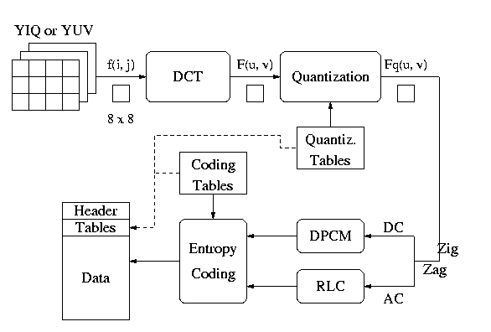
JPEG Encoding
Decoding -- Reverse the order
Dept. of Computer Science and Engineering, University of Rajshahi

Slide 5
Major Steps
1. DCT (Discrete Cosine Transformation)
2. Quantization
3. Zigzag Scan
4. DPCM on DC component
5. RLE on AC Components
6. Entropy Coding
Dept. of Computer Science and Engineering, University of Rajshahi

Slide 6
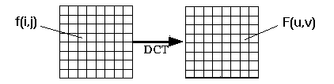
1. Discrete Cosine Transform (DCT)
From spatial domain to frequency domain:
Why DCT not FFT? -- DCT is like FFT, but can approximate linear signals well with few coefficients.
Dept. of Computer Science and Engineering, University of Rajshahi

Slide 7
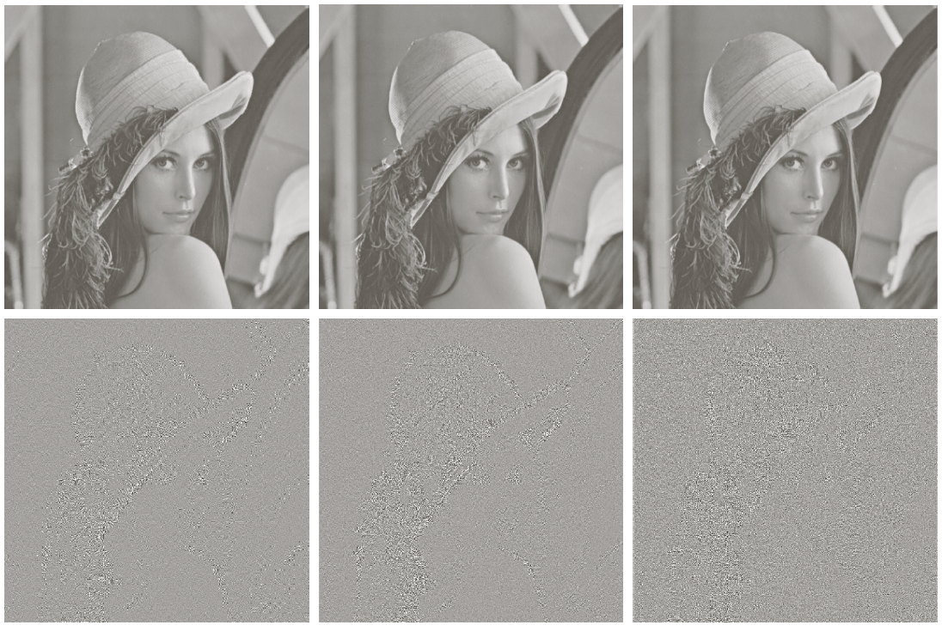
DCT (cont’d)
DFT
DCT
8 x 8 subimages
64 coefficients
per subimage
50% of the
coefficients
truncated
RMS error: 2.32 1.13
Dept. of Computer Science and Engineering, University of Rajshahi

Slide 8
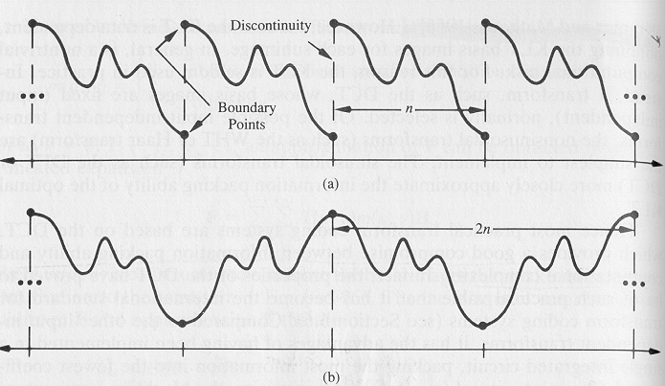
DCT (cont’d)
DCT minimizes "blocking artifacts" (i.e., boundaries between subimages do not become very visible).
DFT
i.e., n-point periodicity
gives rise to
discontinuities!
DCT
i.e., 2n-point periodicity
prevents
discontinuities!
Dept. of Computer Science and Engineering, University of Rajshahi

Slide 9

DCT (cont’d)
Subimage size selection
original
2 x 2 subimages
4 x 4 subimages
8 x 8 subimages
Dept. of Computer Science and Engineering, University of Rajshahi

Slide 10
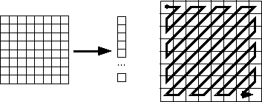
2. Quantization
F'[u, v] = round ( F[u, v] / q[u, v] ).
Why? -- To reduce number of bits per sample.
4. Zig-zag Scan
Why? -- to group low frequency coefficients in top of vector.
Maps 8 x 8 to a 1 x 64 vector .
Dept. of Computer Science and Engineering, University of Rajshahi

Slide 11
4. Differential Pulse Code Modulation (DPCM) on DC component
DC component is large and varied, but often close to previous value.
Encode the difference from previous 8 x 8 blocks – DPCM
5. Run Length Encode (RLE) on AC components
1 x 64 vector has lots of zeros in it
Keeps skip and value, where skip is the number of zeros and value is the next non-zero component.
Send (0,0) as end-of-block (EOB) sentinel value.
Dept. of Computer Science and Engineering, University of Rajshahi

Slide 12
6. Entropy Coding
Categorize DC values into SIZE (number of bits needed to represent) and actual bits.
Example: if DC value is 4, 3 bits are needed.
For AC components two symbols are used: Symbol_1: (skip, SIZE), Symbol_2: actual bits. Symbol_1 (skip, SIZE) is encoded using the Huffman coding, Symbol_2 is not encoded.
Huffman Tables can be custom (sent in header) or default.
Dept. of Computer Science and Engineering, University of Rajshahi

Slide 13


DCT
forward
inverse
if u=0
if v=0
if u>0
if v>0
Dept. of Computer Science and Engineering, University of Rajshahi

Slide 14
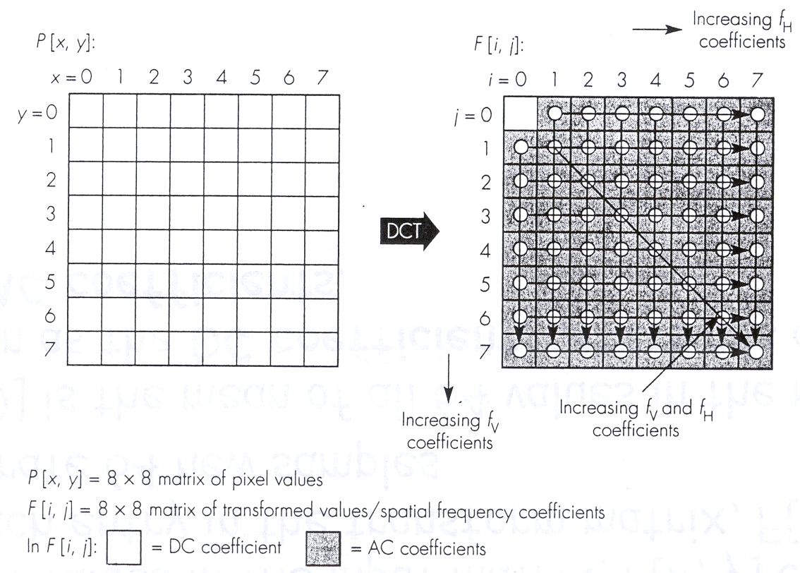
DCT Computation Features
Dept. of Computer Science and Engineering, University of Rajshahi

Slide 15
JPEG Steps
1. Divide the image into 8x8 subimages;
For each subimage do:
2. Shift the gray-levels in the range [-128, 127]
3. Apply DCT (64 coefficients will be obtained: F[0,0] is the mean of all 64 values in the matrix, known as the DC coefficient, others are called as the AC coefficients.
4. Quantize the coefficients (i.e., reduce the amplitude of coefficients that do not contribute a lot).
Quantization
Table
Dept. of Computer Science and Engineering, University of Rajshahi

Slide 16
JPEG Steps (cont’d)
5. Order the coefficients using zig-zag ordering
- Place non-zero coefficients first
- Create long runs of zeros (i.e., good for run-length encoding)
6. Encode coefficients.
All coefficients are converted to a binary sequence:
6.1 Form intermediate symbol sequence
6.2 Apply Huffman coding (i.e., entropy coding)
Dept. of Computer Science and Engineering, University of Rajshahi

Slide 17
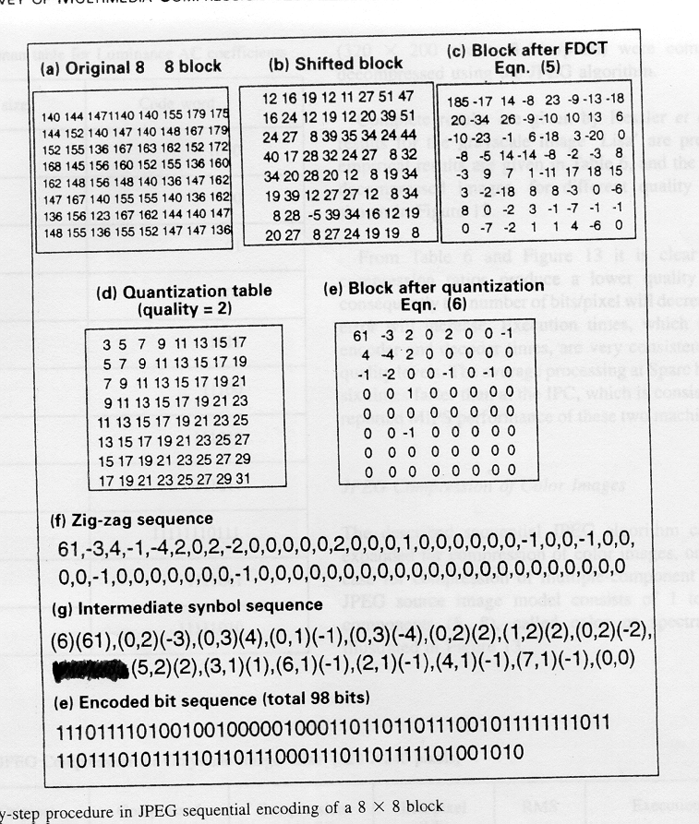
Shifting
Shift the gray-levels in the range [-128, 127]
Dept. of Computer Science and Engineering, University of Rajshahi

Slide 18
DCT
Forward
Dept. of Computer Science and Engineering, University of Rajshahi

Slide 19

Quantization
Quantization Table Example
Dept. of Computer Science and Engineering, University of Rajshahi

Slide 20
Quantization (cont’d)
Dept. of Computer Science and Engineering, University of Rajshahi
Notes:
20

Slide 21
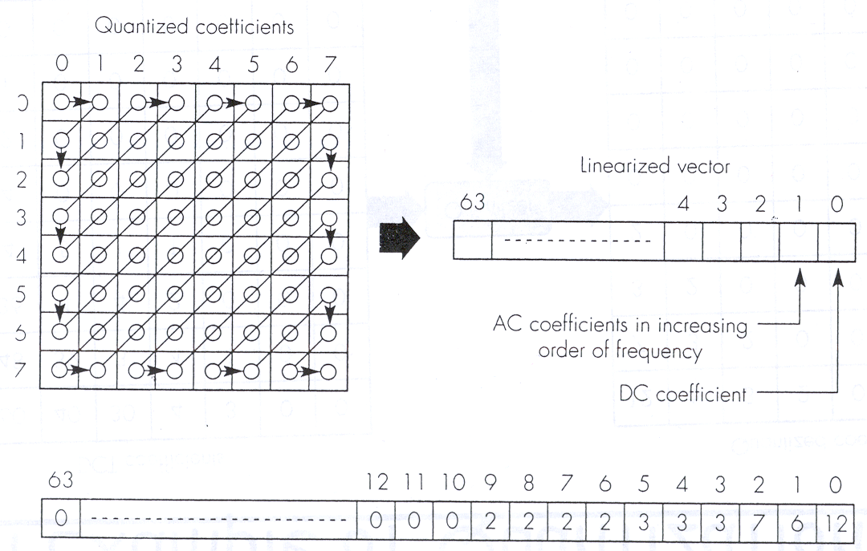
Zig-Zag Ordering
Dept. of Computer Science and Engineering, University of Rajshahi
Notes:
21

Slide 22
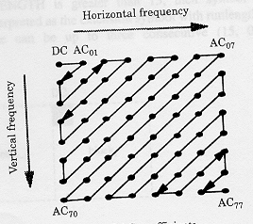
Zig-Zag Ordering (cont’d)
Dept. of Computer Science and Engineering, University of Rajshahi
Notes:
22

Slide 23
Huffman Encoding
Use variable length codes
Most frequently used symbols coded with fewest bits
The intermediate symbol sequence
DC coefficient: (sss, value)
sss: the number of bits needed
value: the encode value
AC coefficient: (skip, sss) (value) with run-length encoding
skip: the number of consecutive 0s
sss: the number of bits needed to encode the value
value: the encode value
Huffman code
DC coefficients: 12 = (4, 12) = (1011100)
AC coefficient: (0, 6) = (0, 3) (6) = (100110)
Dept. of Computer Science and Engineering, University of Rajshahi

Slide 24
Baseline Entropy Coding Symbol-2 Structure
SIZE AMPLITUDE
0 0 1 -1,1 2 -3,-2,2,3 3 -7, … -4,4 … 7 . . . . . . 10 -1023..-512,512..1023 11 -2047..-1024,1024..2047
Dept. of Computer Science and Engineering, University of Rajshahi

Slide 25
Intermediate Coding (cont’d)
symbol_1, symbol_2
DC (6) (61)
AC (0,2) (-3)
End of Block
Dept. of Computer Science and Engineering, University of Rajshahi

Slide 26
Entropy Encoding (cont’d)
Dept. of Computer Science and Engineering, University of Rajshahi
Notes:
26

Slide 27
Entropy Encoding (cont’d)
Intermediate symbol sequence
(6)(62), (0,3)(-4), (0,3)(4), (0,2)(-2), (0,3)(-5), (0,2)(2), (0,1)(-1), (0,2)(3), (0,2)(-3), (0,1)(-1), (3,1)(-1), (0,2)(2), (0,1)(-1), (0,1)(-1), (1,1)(1), (0,1)(1), (1,1)(1), (1,1)(1), (0,1)(-1), (0,1)(-1), (0,1)(1), (0,1)(-1), (0,1)(-1), (0,1)(1), (3,1)(-1), (5,1)(-1), (1,1)(-1), (3,1)(1), (6,1)(1), (1,1)(1), (0,0)
Encoded bit sequence (total 154 bits)
(1110)(111110) (100)(001) (100)(100) (01)(01) (100)(010) (01)(10) (00)(0) (01)(11) (01)(00) (00)(0) (111010)(0) (01)(10) (00)(0) (00)(0) (1100)(1) (00)(1) (1100)(1) (1100)(1) (00)(0) (00)(0) (00)(1) (00)(0) (00)(0) (00)(1) (111010)(0) (1111010)(0) (1100)(0) (111010)(1) (1111011)(1) (1100)(1) (1010)
Dept. of Computer Science and Engineering, University of Rajshahi
Notes:
27

Slide 28
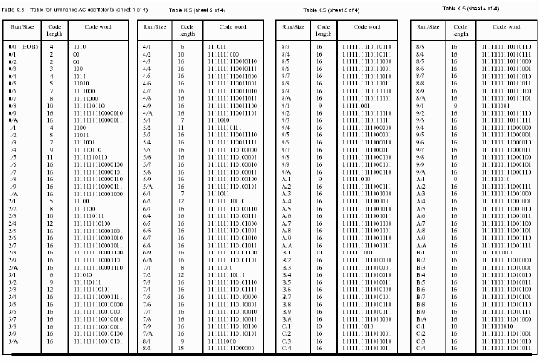
Table for luminance AC coefficients
Dept. of Computer Science and Engineering, University of Rajshahi

Slide 29
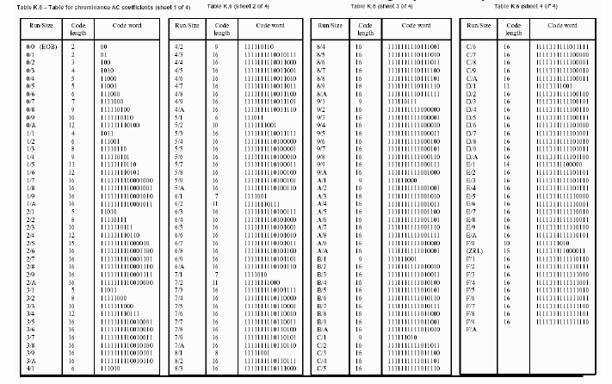
Table for chrominance AC coefficients
Dept. of Computer Science and Engineering, University of Rajshahi

